Slide 1
String Searching Algorithms

Slide 2
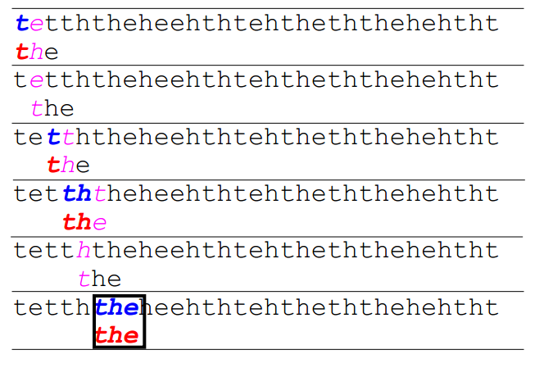
Brute Force

Slide 3
do
if (text letter == pattern letter)
compare next letter of pattern to next letter of text
else
move pattern down text by one letter
while (entire pattern found OR end of text)

Slide 4
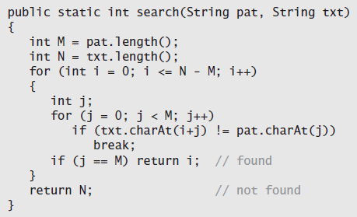

Slide 5
Brute-force substring search requires ~NM character compares to search for a pattern of length M in a text of length N, in the worst case. (next slide)
If none of the characters are in the search string, then the worst case is N.
Brute force algorithms requires us to back up in the text when we find a mismatch.

Slide 6
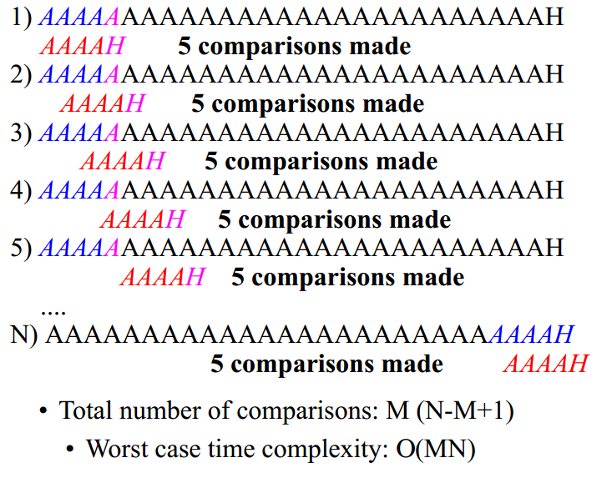

Slide 7
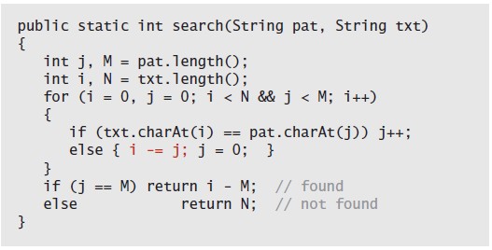

Slide 8
Knuth-Morris-Pratt substring search
Whenever we detect a mismatch, we already know some of the characters in the text (since they matched the pattern characters prior to the mismatch).
Always manages to avoid backing up.

Slide 9

Can we skip some characters?
First detect the mismatch at position 5, but we had better restart at position 3 to continue the search, since otherwise we would miss the match.

Slide 10
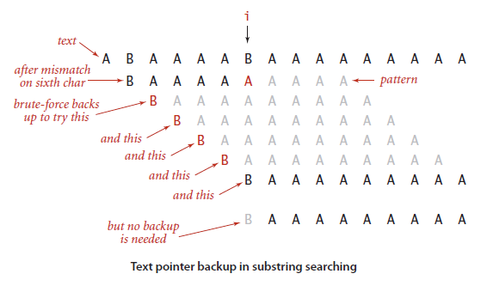
Since our inner loop has already seen the next 6 characters, if we could some how make our algorithm remember what those characters were, we would not need to back up.

Slide 11
DFA
Deterministic Finite Automaton.
We make each character of our pattern as a state.
When we read a character, we decide whether to jump to the next state or not based on the character.
The state shows how many characters we have matched.

Slide 12
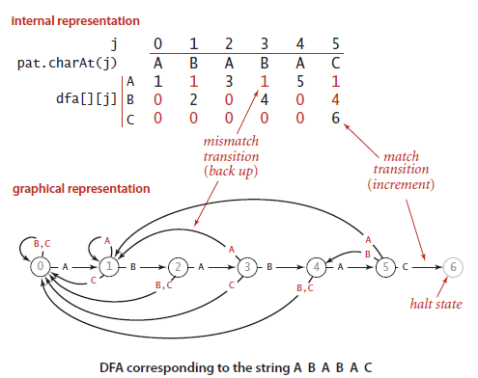

Slide 13
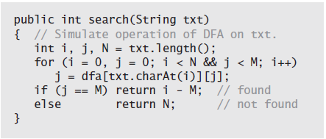

Slide 14
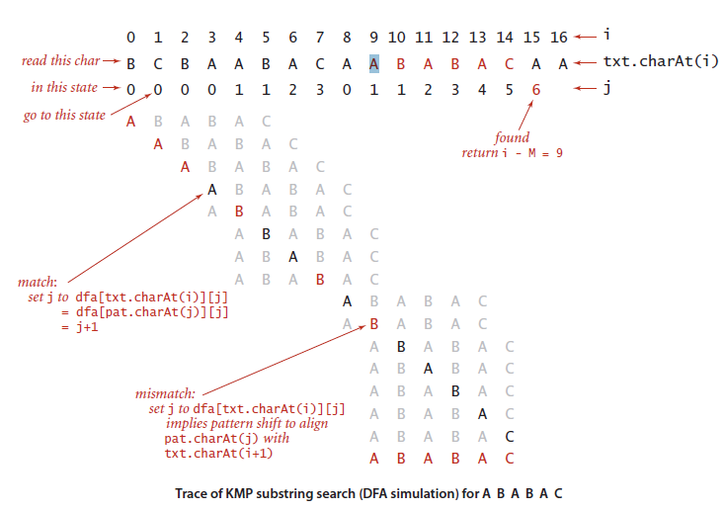

Slide 15
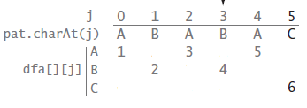
Constructing the DFA
Called preprocessing phase.
Will need to create DFA.

Slide 16
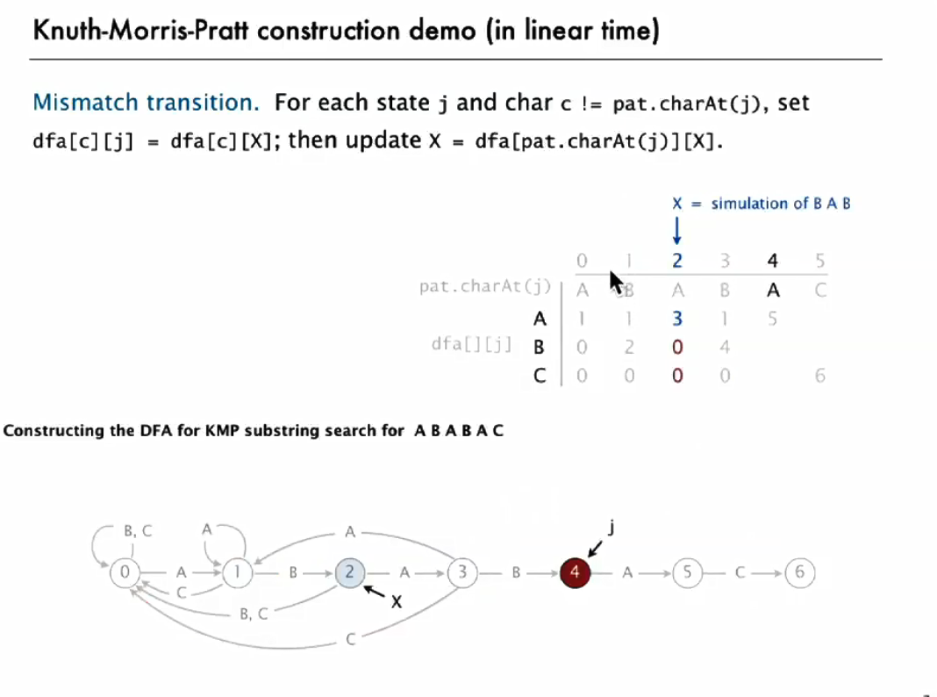

Slide 17
Other implementations also possible, which calculate the number of characters ‘i’ could jump.
Knuth-Morris-Pratt substring search accesses no more than M+N characters to search for a pattern of length M in a text of length N.

Slide 18
Boyer-Moore
A significantly faster substring-searching method by scanning the pattern from right to left.
But, we would need to back up in the text string.

Slide 19
Boyer Moore
Algorithm:
(1) if we try matching a character that is not in p then we can jump forward n characters.
(2) if we try matching a character whose last position is k from the end of p (the pattern) then we can jump forward k characters (from the mismatch).
Intuition:
If the mismatch occurs k characters from the start of p and the mismatched character is not in p, then we can advance (at least) k characters.
If we know that at the old i we'd already matched some characters, if the matched characters don't match the start of p, then we can actually jump forward a little more (this extra distance is called 'delta2')

Slide 20
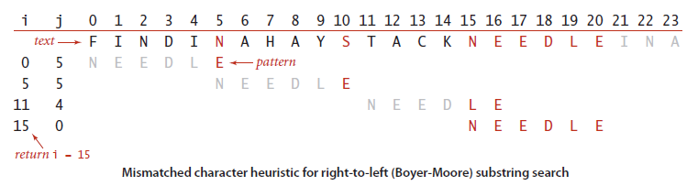
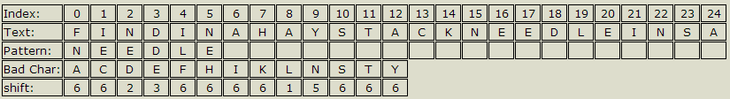

Slide 21
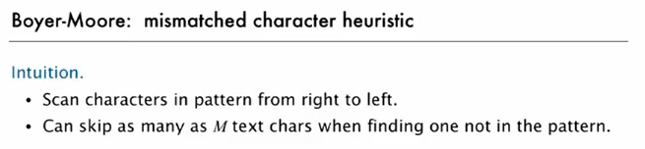

Slide 22
Pre-computation
Create a character list.
Decides how many characters to advance when there is a hit or a miss.

Slide 23
http://stackoverflow.com/a/6209778
Very good step by step intuition.

Slide 24
http://www.utdallas.edu/~besp/demo/John2010/boyer-moore.htm //Small mistake in algo.
http://whocouldthat.be/visualizing-string-matching/
Very good animation and explanation

Slide 25
On typical inputs, substring search with the Boyer-Moore mismatched character heuristic uses ~N/M character compares to search for a pattern of length M in a text of length N.

Slide 26
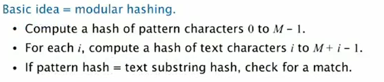
Rabin-Karp fingerprint search
We need a hash function to convert an M-digit base-R number to an int value between 0 and Q-1. Modular hashing provides an answer.
We use a random prime Q, taking as large a value as possible while avoiding overflow.

Slide 27
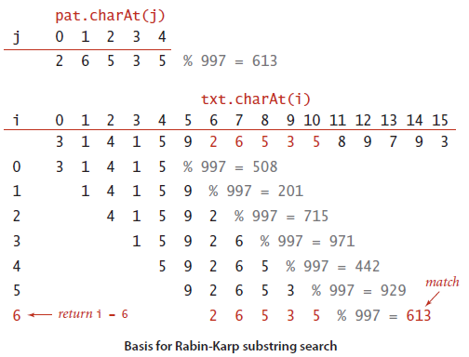
Basis

Slide 28
But, computing a hash function that involves every character is likely to be much more expensive than just comparing characters.
Also, our pattern won’t always be equal to 5 digits.
It may be equal to 100 digits.
So (Number) % 997 would fail in this case.
So we use a method called Horner’s method.

Slide 29
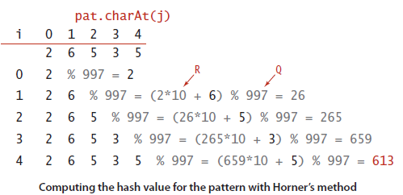
2*10,000 + 6*1000 + 5*100 + 3*10 + 5*1 = 26535
So one problem solved.
But still, computing hash for M characters from the input text will still be quite expensive.

Slide 30
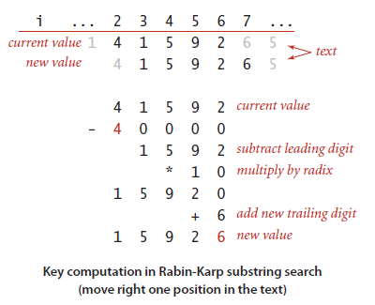
The Rabin-Karp method is based on efficiently computing the hash function for position i+1 in the text, given its value for position i.
We subtract off the leading digit, multiply by R, then add the trailing digit.

Slide 31
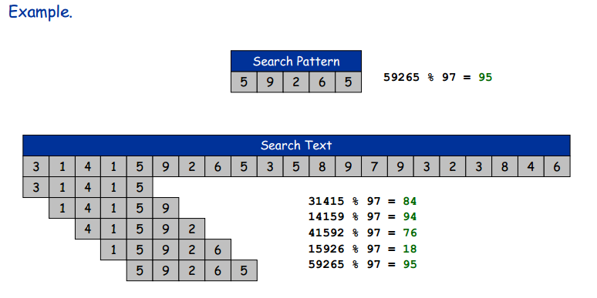
Example

Slide 32
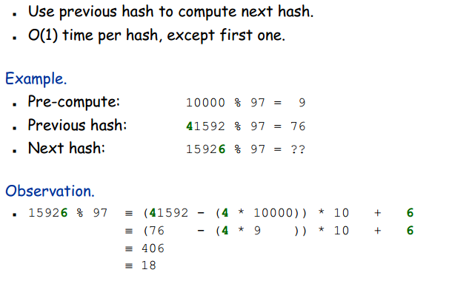
(subtract off the leading digit, multiply by R, then add the trailing digit.)
Rabin Karp

Slide 33
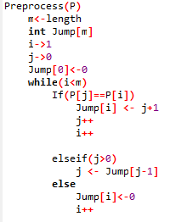
KMP reloaded

Slide 34
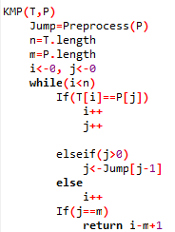

Slide 35
References
http://stackoverflow.com/questions/6207819/boyer-moore-algorithm-understanding-and-example
http://www.mathcs.emory.edu/~cheung/Courses/323/Syllabus/Text/Matching-KMP1.html

